Slide 1

ASF Standing Group of Experts (SGE) Africa
GF-TADs Africa, Regional Secretariat (WOAH)

Slide 2
Presentation Outline
  About SGE
    SGE I : Key topics
      SGE II : Other diseases of concern
        Country Actions from SGE II
          Next steps

Slide 3
About SGE
Resolution No. 33 of the 87th WOAH General Session recognised the complexity of ASF, the response to which requires multisectoral and multi-institutional cooperation.
Global Initiative (GI) recognizes that global control of ASF is feasible, but unlikely to be successful and sustainable without determined national efforts, hence need for coordination of control measures at regional and global level.
SGE promotes national, regional and global partnerships, to strengthen prevention and preparedness measures, and to minimize the adverse impacts of ASF on the health and welfare of pigs and on international trade
SGE was established in response to the GI, under Africa GF-TADs umbrella, an approval in 11th RSC of October 2021.
  SGE comprises a team of experts committed to provide their expertise for many years in order to support the initiative for the Global control of ASF in Africa.
  Inaugural Meeting : 23 – 24 March 2022
  Terms of Reference of the SGE for ASF adopted

Slide 4
Technical items or topics identified (in order of priority):
  1. Value chains [21-22 Sep.]
  2. Biosecurity
  3. Surveillance
  4. Outbreak management
  5. Socio-economics
  6. Cross-border
  7. Policy
  8. Transparency

Slide 5
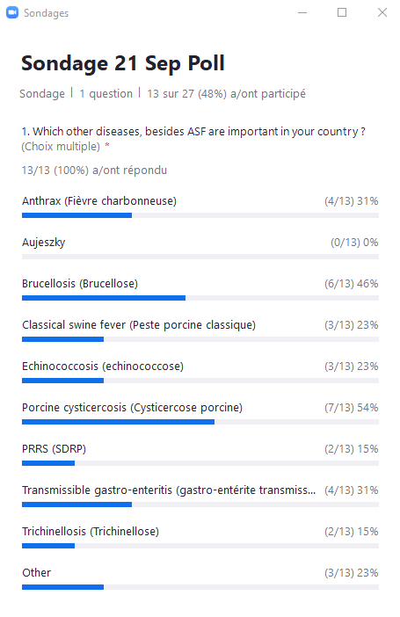
Zoom poll: Other important pig diseases
Under “other” diseases, several notifiable and non-notifiable diseases were mentioned :
  Porcine circovirus,
  Foot-and-mouth disease (FMD),
  Erysipelas,
  Mycoplasma spp.,
  Actinobacillus pneumonia,
  Mange (scabies),
  Salmonella spp. and
  E. coli.

Slide 6
Risk Factors for ASF
Indiscriminate supply of pigs
Indiscriminate supply of feed and interactions in feed mills
Use of untested water - streams, wells,
Location of slaughterhouses in the pig rearing areas, coupled with biosecurity risks
Sharing of boars within farming communities
Unrestricted entry of live pigs and pig products

Slide 7
SGE II Meeting Outcomes:
Countries use existing tools as guides for value chain and risk analysis: e.g. capacity building through FAO Virtual Learning Centres (VLCs), coordination with collaborating partners supporting capacity building for value chain analysis
Common approach to VCA => Next topics on biosecurity
Implementation of the Global Initiative for ASF
Capacity to manage other pig diseases of public health importance such as porcine cysticercosis, echinococcosis and trichinellosis

Slide 8
Improved Capability of countries to manage ASF and other priority pig diseases though adequate support mechanisms
Improved coordination and cooperation of key stakeholders from the private and public sector, and minimise the consequences of ASF through business continuity
Improved risk management through development and refinement of national control programmes, and the need to recognise risk communication as a crucial component of effectively addressing risk pathways and high-risk practices.
Countries maintain transparency through timely disease notification and manage risks by implementing the international standards in relation to zoning, compartmentalisation and applying commodity-based trade measures
Next steps: SGE III
Expected Outcomes
  1. Value chains
  2. Biosecurity along value chains
  3. Surveillance
  4. Outbreak management
  5. Socio-economics
  6. Cross-border
  7. Policy
  8. Transparency
Likely in July 2023, in Abidjan, C/d’Ivoire

Slide 9
Thank you

